Slide 1
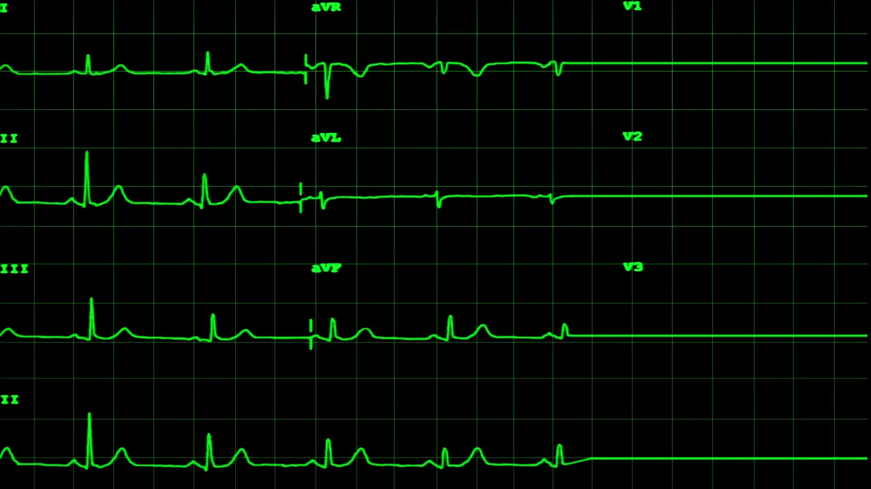
Atrial Fibrillation & Secondary Stroke Prevention: Therapeutics & Prolonged Cardiac Rhythm Monitoring

Slide 2

Objectives
Atrial fibrillation (AF) and stroke risk
Anticoagulation (AC)
Special populations
Timing of initiation after stroke
Ischemic stroke (IS) despite AC
Rhythm control & Factor XI/XIa inhibitors
AF evaluation after IS
Prolonged cardiac rhythm monitoring
AF burden and IS risk
Atrial high-rate episodes
Wearables

Slide 3
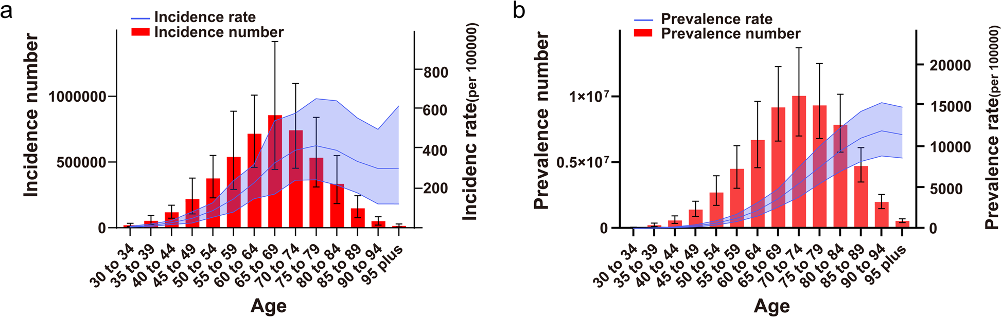
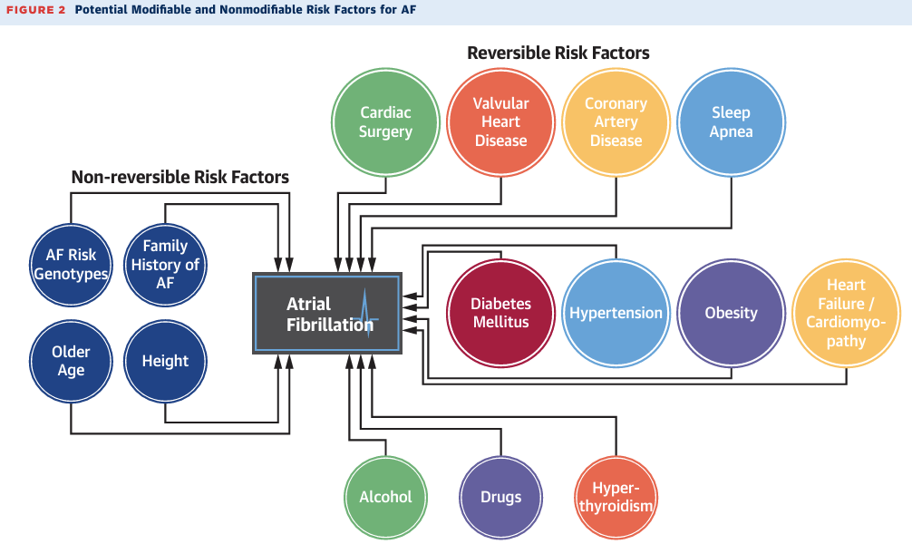
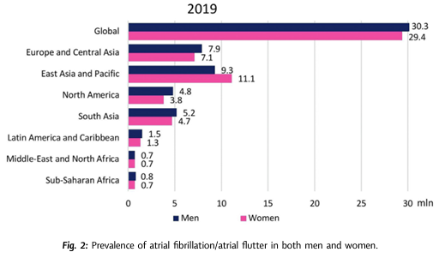
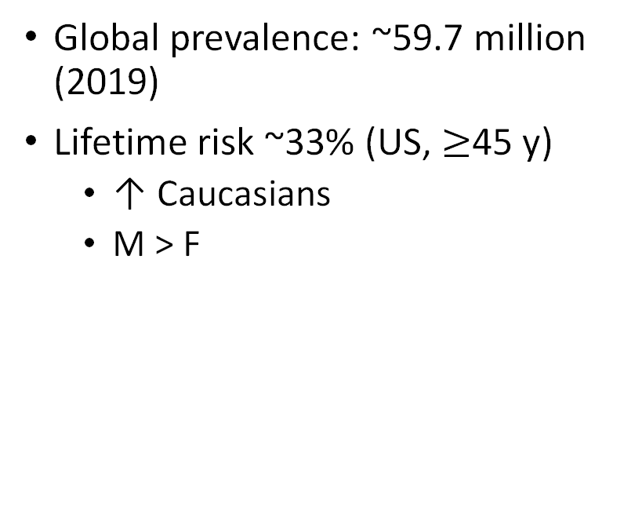
Atrial Fibrillation
Global prevalence: ~59.7 million (2019)
Lifetime risk ~33% (US, $≥$45 y)
↑ Caucasians
M > F

Slide 4
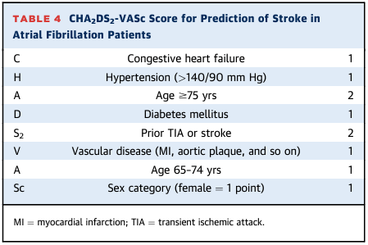
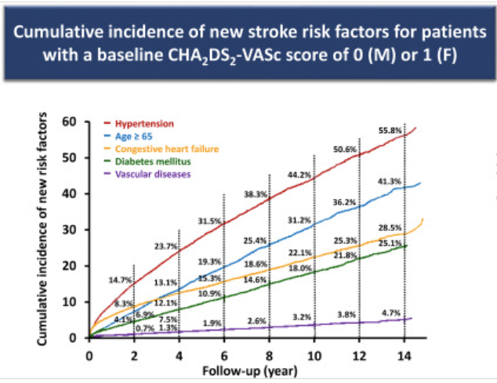
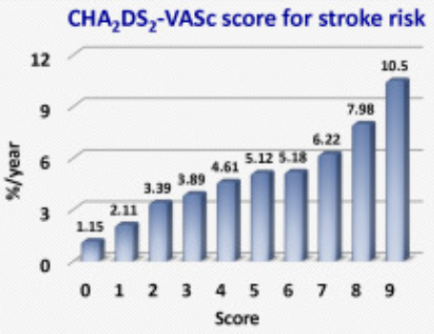
AF & Stroke Risk
Non-valvular AF: ↑ 5x risk
AF w/ mitral stenosis: ↑ 20x
20-30% of IS
Risk prediction models
CHA₂DS₂-VASc
* female sex → risk modifier
ATRIA, GARFIELD
ML → c-index ~0.87
*multimorbidity
*risk is dynamic

Slide 5
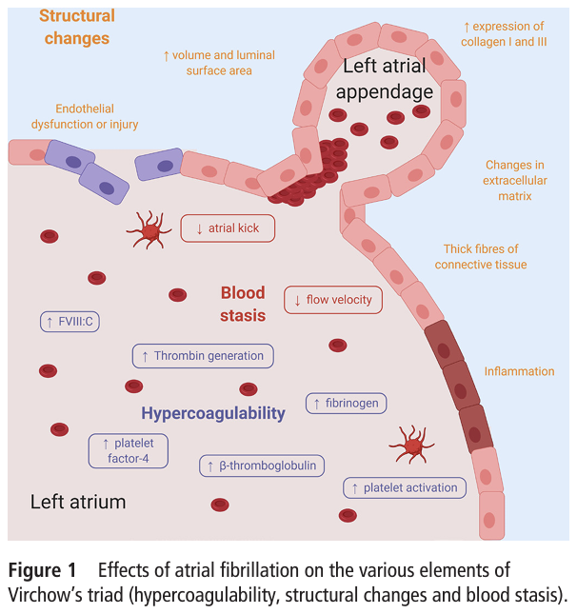
Thromboembolism
Stasis
Atrial structure (remodeling, dilation) & contraction
Hypercoagulability
Endothelial dysfunction

Slide 6
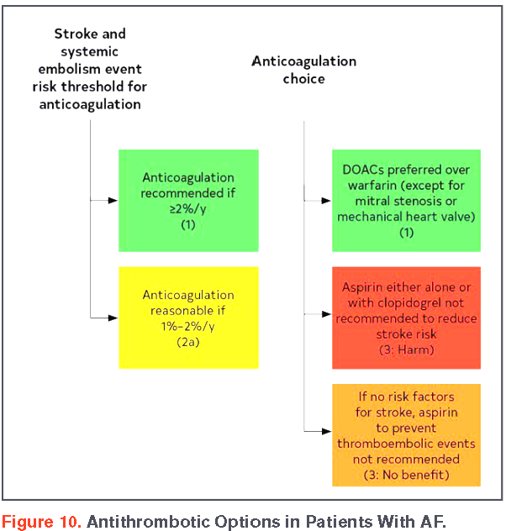
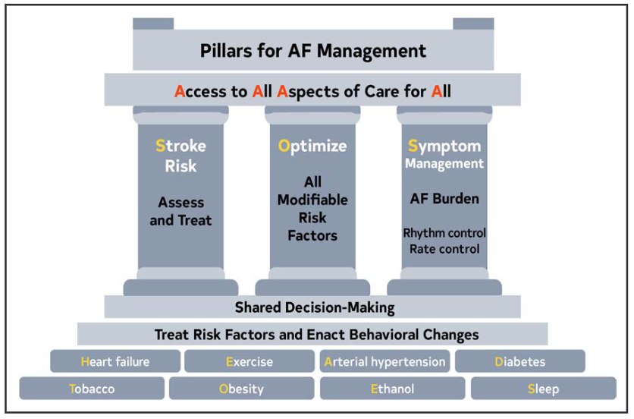
AF Management

Slide 7
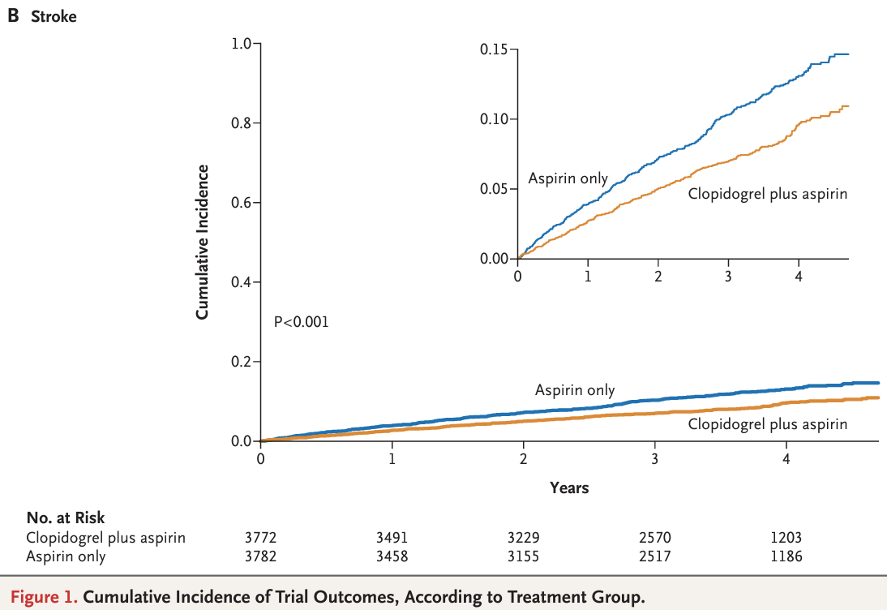
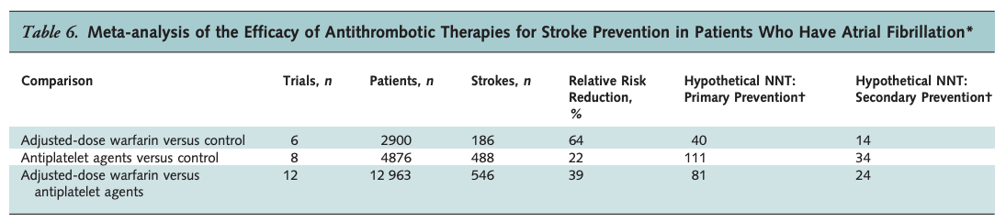
Antiplatelets & Warfarin
Aspirin → RRR ~22%
* SPAF-1
Aspirin + Clopidogrel
ACTIVE A → RR 0.72
ARR: 0.9%
Major hemorrhage (DAPT): ~2%/yr
ACTIVE W → RR 0.69
Warfarin vs aspirin/clopidogrel
Warfarin → RRR ~64%

Slide 8
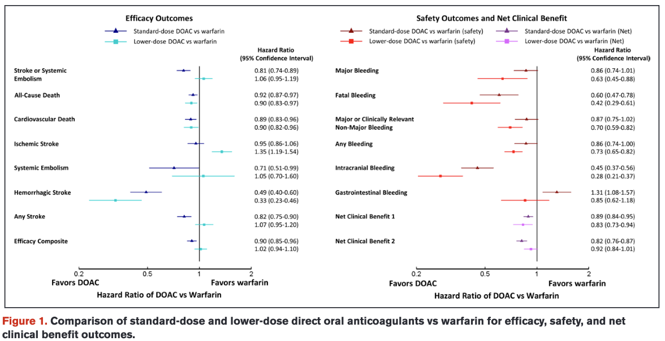
Direct Oral Anticoagulants – Efficacy & Safety

Slide 9
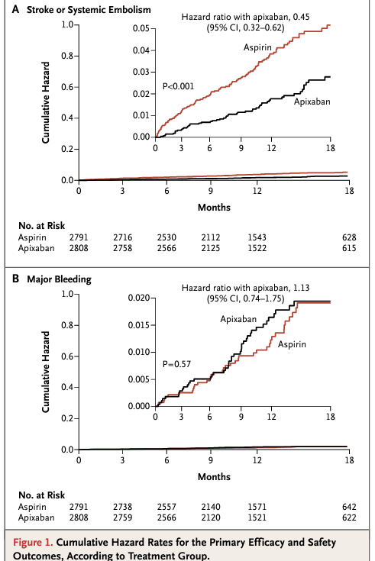
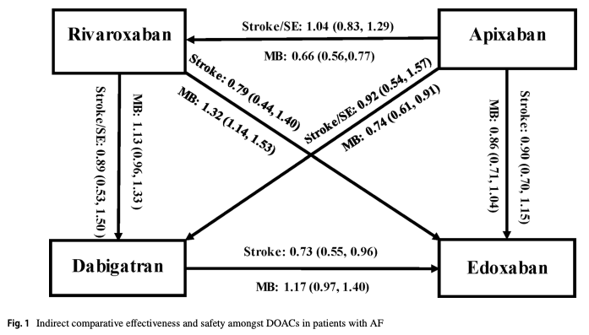
Effectiveness
AVERROES

Slide 10
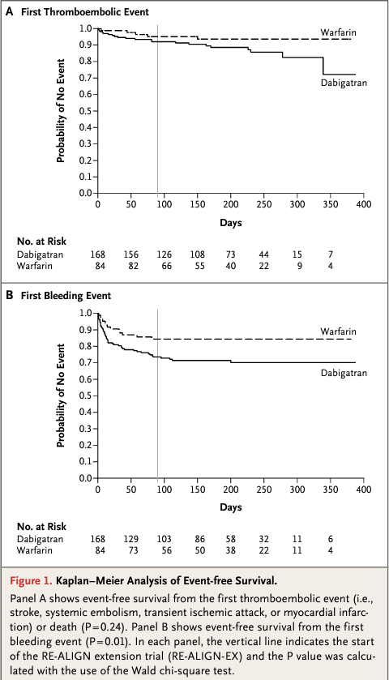
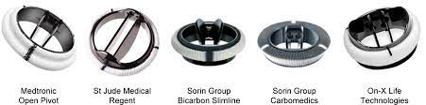
Special Populations
DOAC trials for AF – exclusions:
pregnancy
mechanical heart valve
moderate-severe MV stenosis
ESRD/dialysis

Slide 11
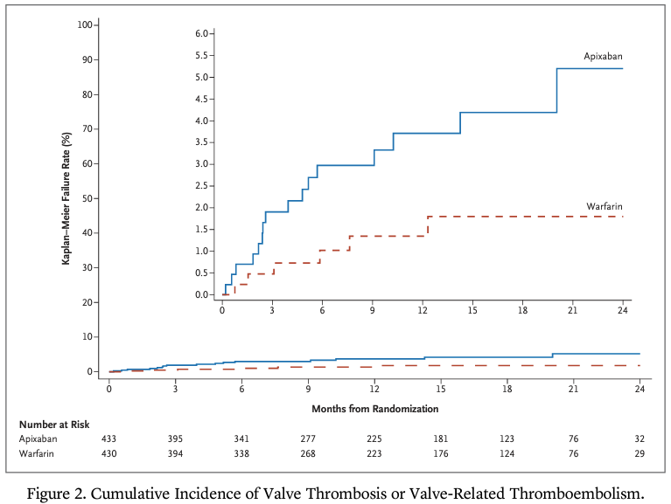
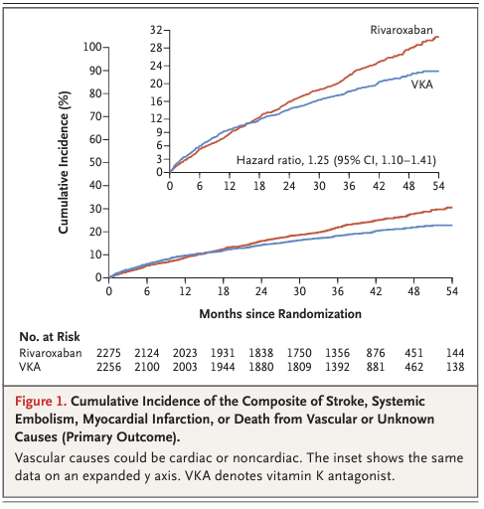
Mitral Valve Stenosis
PROACT Xa
INVICTUS

Slide 12
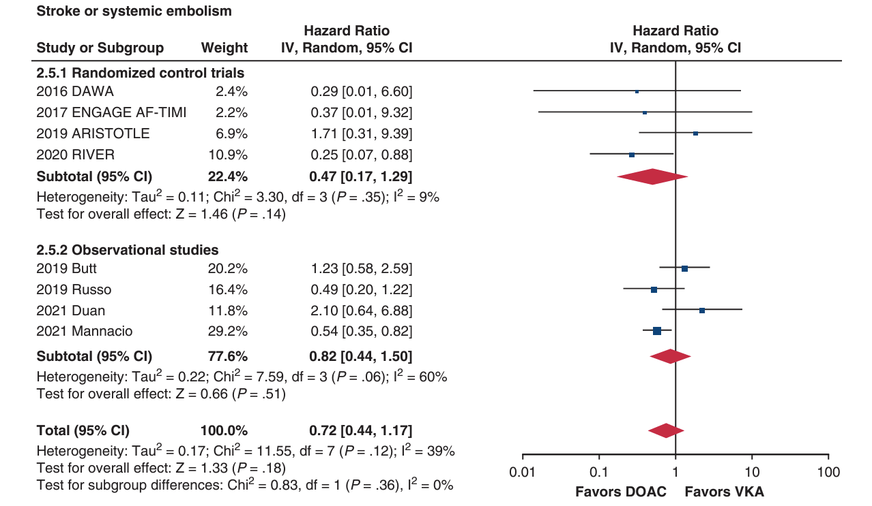
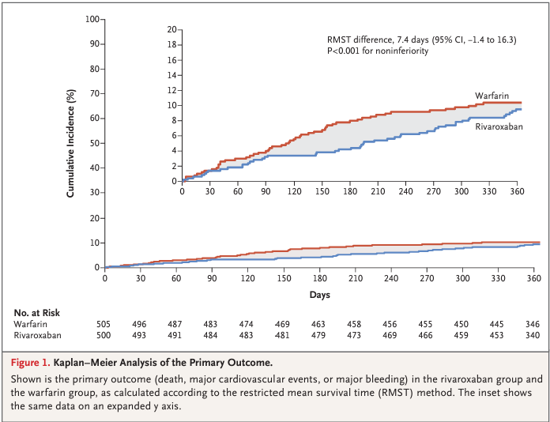
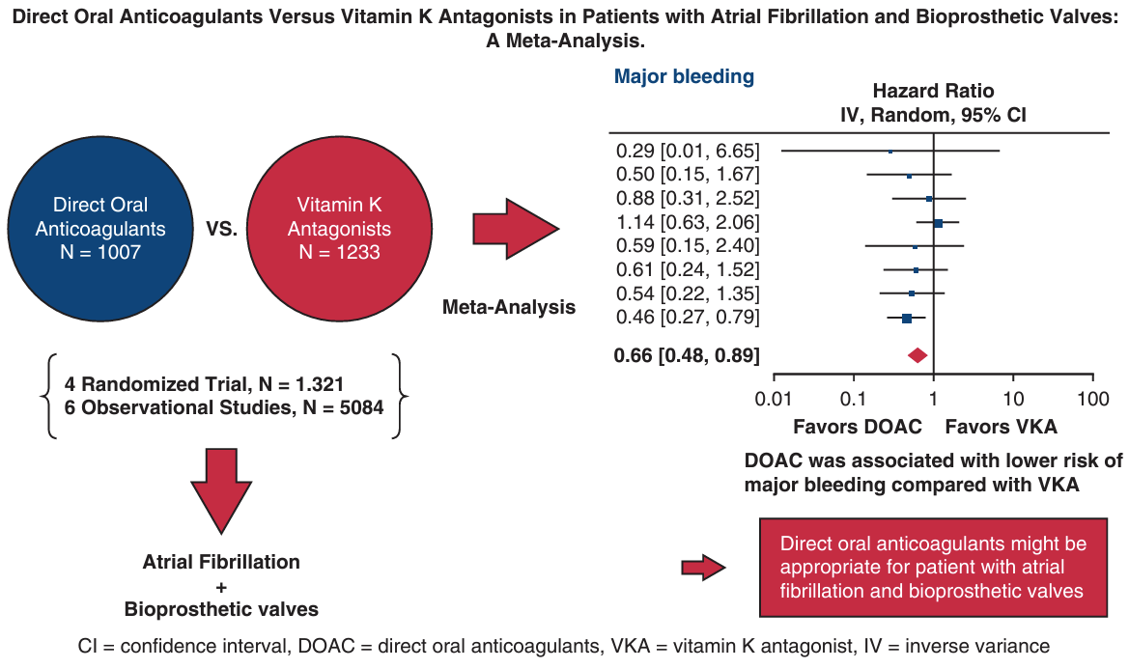
Bioprosthetic Valves
RIVER
Transcatheter Aortic Valve Implantation + AF → edoxaban & apixaban ~ warfarin

Slide 13
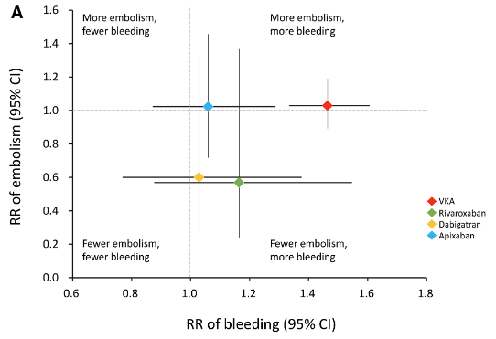
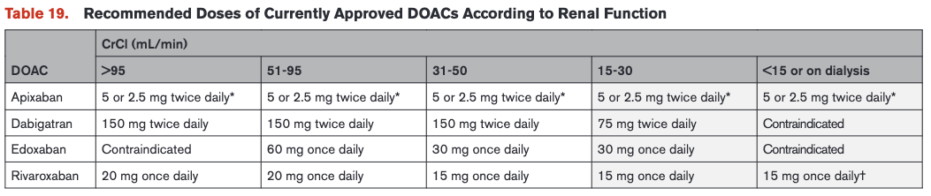
ESRD / Dialysis
CKD → risk factor for stroke in AF
Stage IV CKD (observational) → DOAC
→ apixaban or warfarin reasonable in ESRD

Slide 14
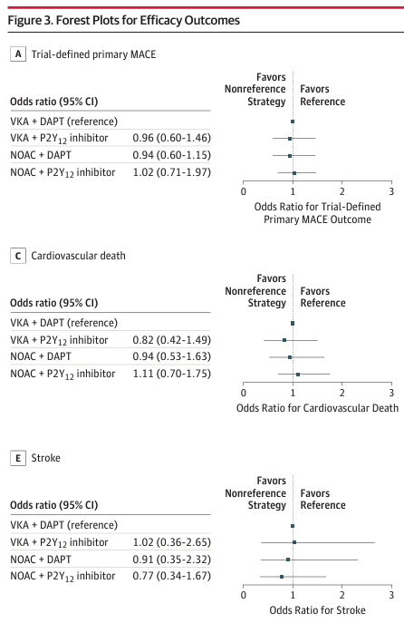
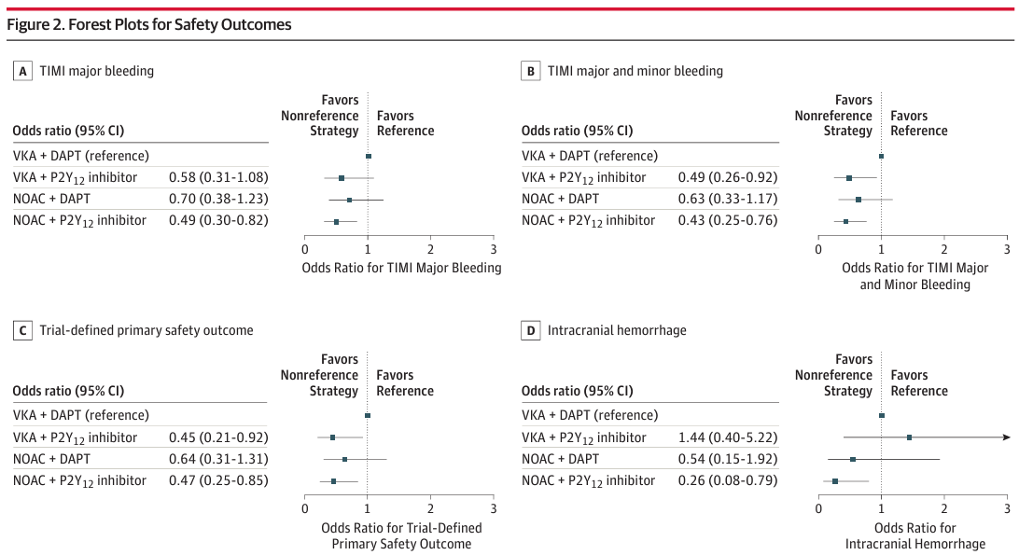
Percutaneous Coronary Intervention
DOAC + P2Y₁₂ inhibitor: ↓ risk of major hemorrhage & ICH

Slide 15
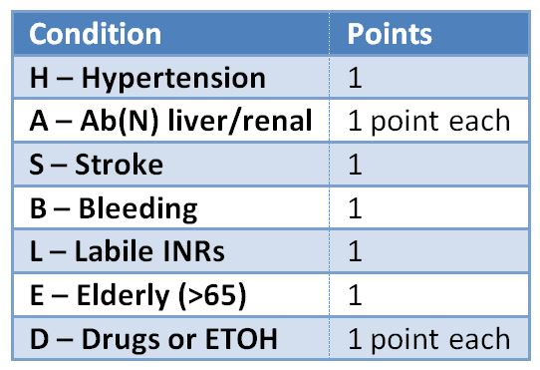
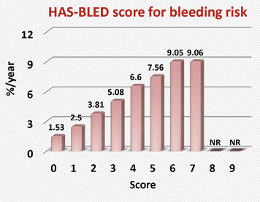
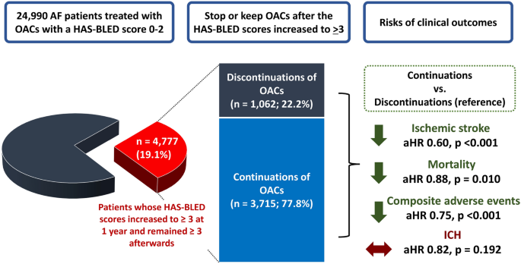
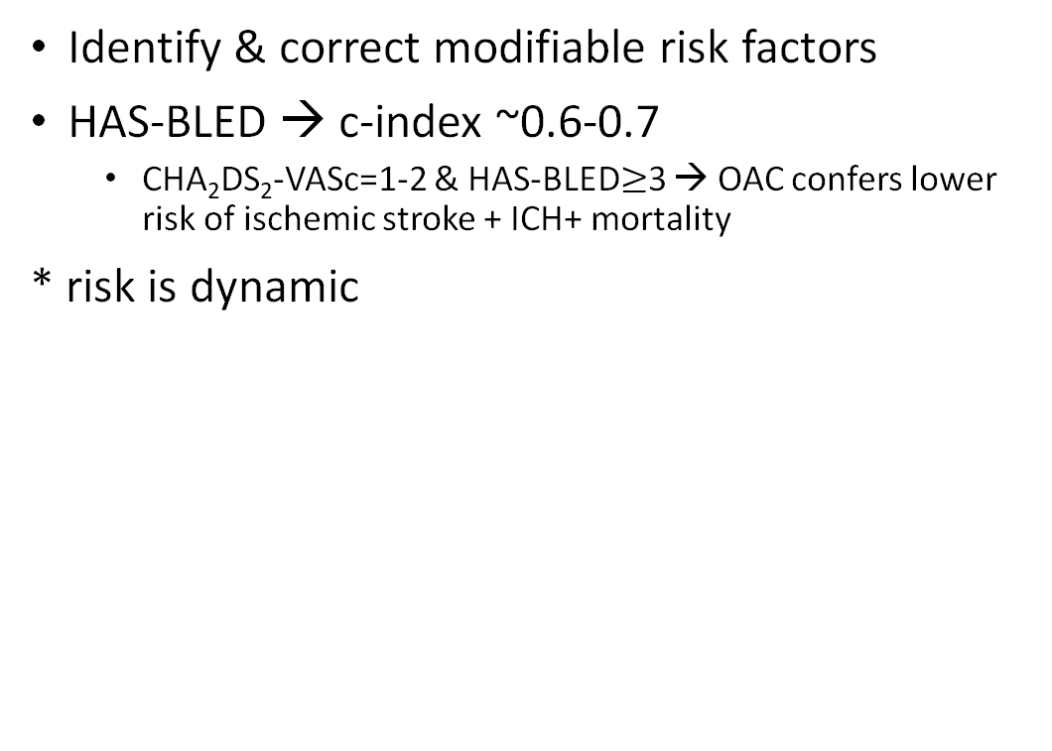

Bleeding Risk $≠$ Avoid Anticoagulation
Identify & correct modifiable risk factors
HAS-BLED → c-index ~0.6-0.7
CHA₂DS₂-VASc=1-2 & HAS-BLED$≥$3 → OAC confers lower risk of ischemic stroke + ICH+ mortality
* risk is dynamic

Slide 16
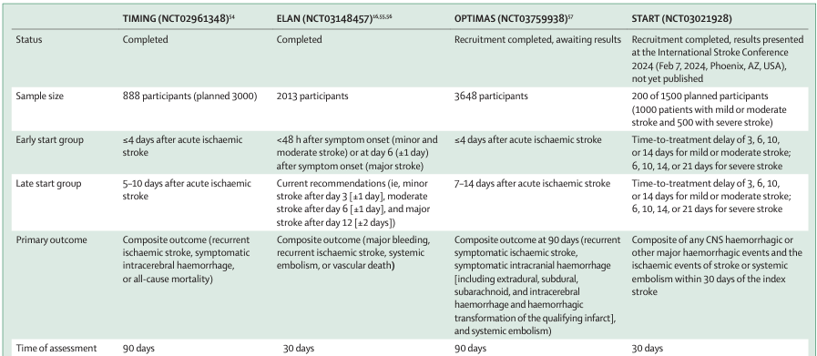
Timing of AC After IS
Small-moderate infarct → ≤48 hours
Large infarct → 1-2 weeks

Slide 17
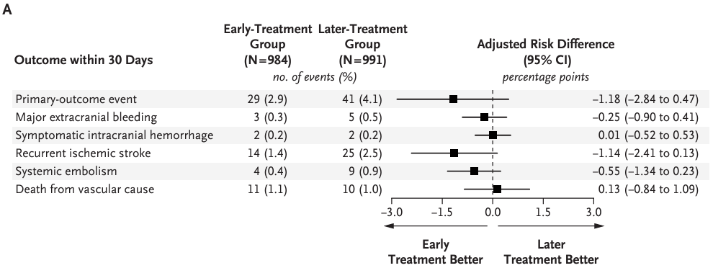
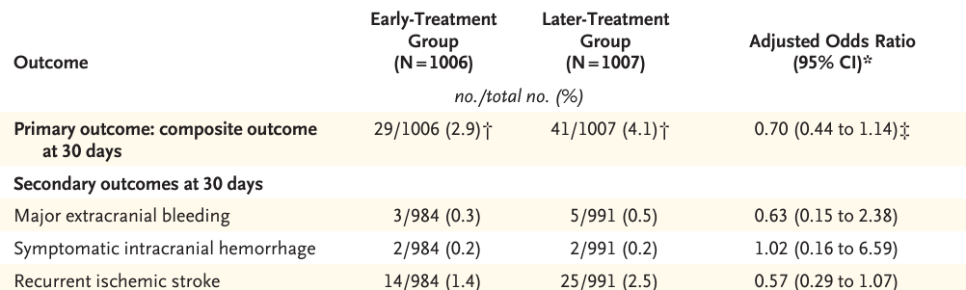
Early vs Later AC for Stroke w/ AF (ELAN)
Population: acute IS + AF
Intervention/Control: early/late DOAC
Early: ≤48h minor/moderate, 6/7d major
Late: 3/4d minor, 6/7d moderate, 12/13/14d major
1° Outcome: composite – recurrent IS, SE, sx ICH, major extracranial hemorrhage, vascular death @ 30d
Stroke severity: median NIHSS 5 (IQR 2-12)
Minor (37%): ≤1.5cm
Moderate (40%): cortical superficial branch of MCA/ACA/PCA distribution
Major (23%): large volume in MCA/ACA/PCA distribution OR >1.5cm in brainstem/cerebellum

Slide 18
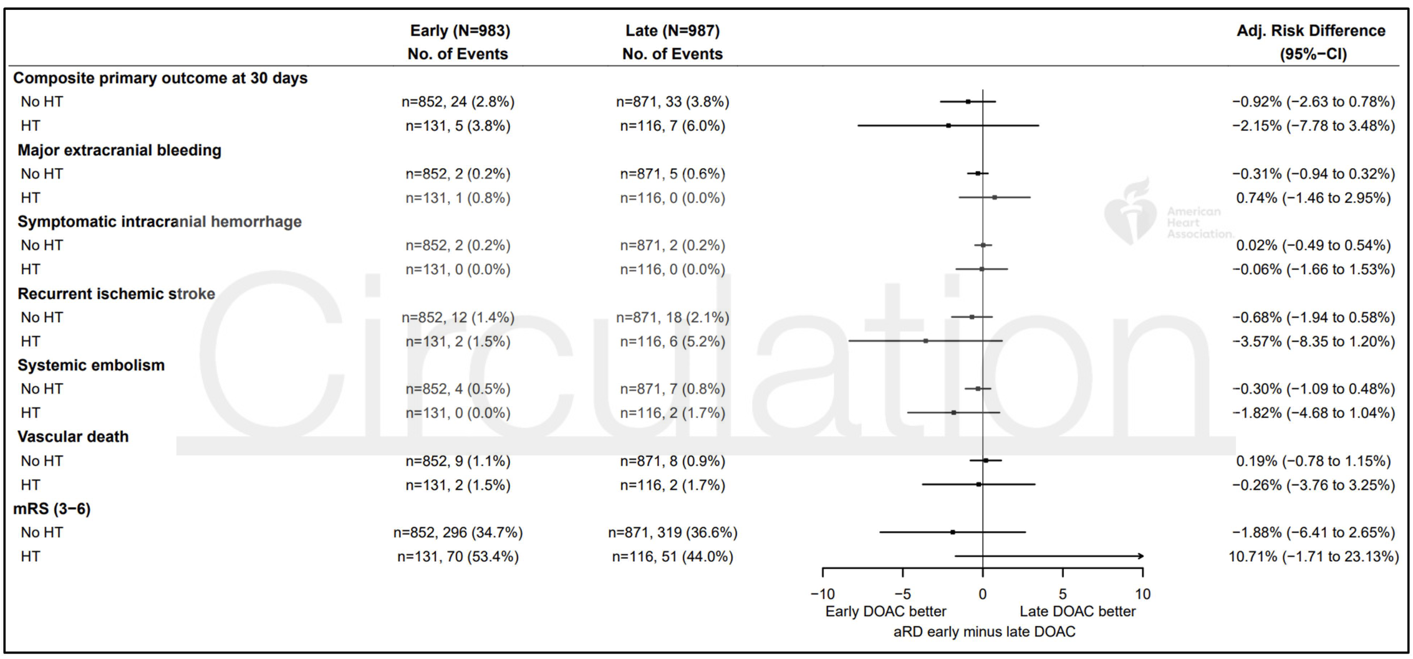
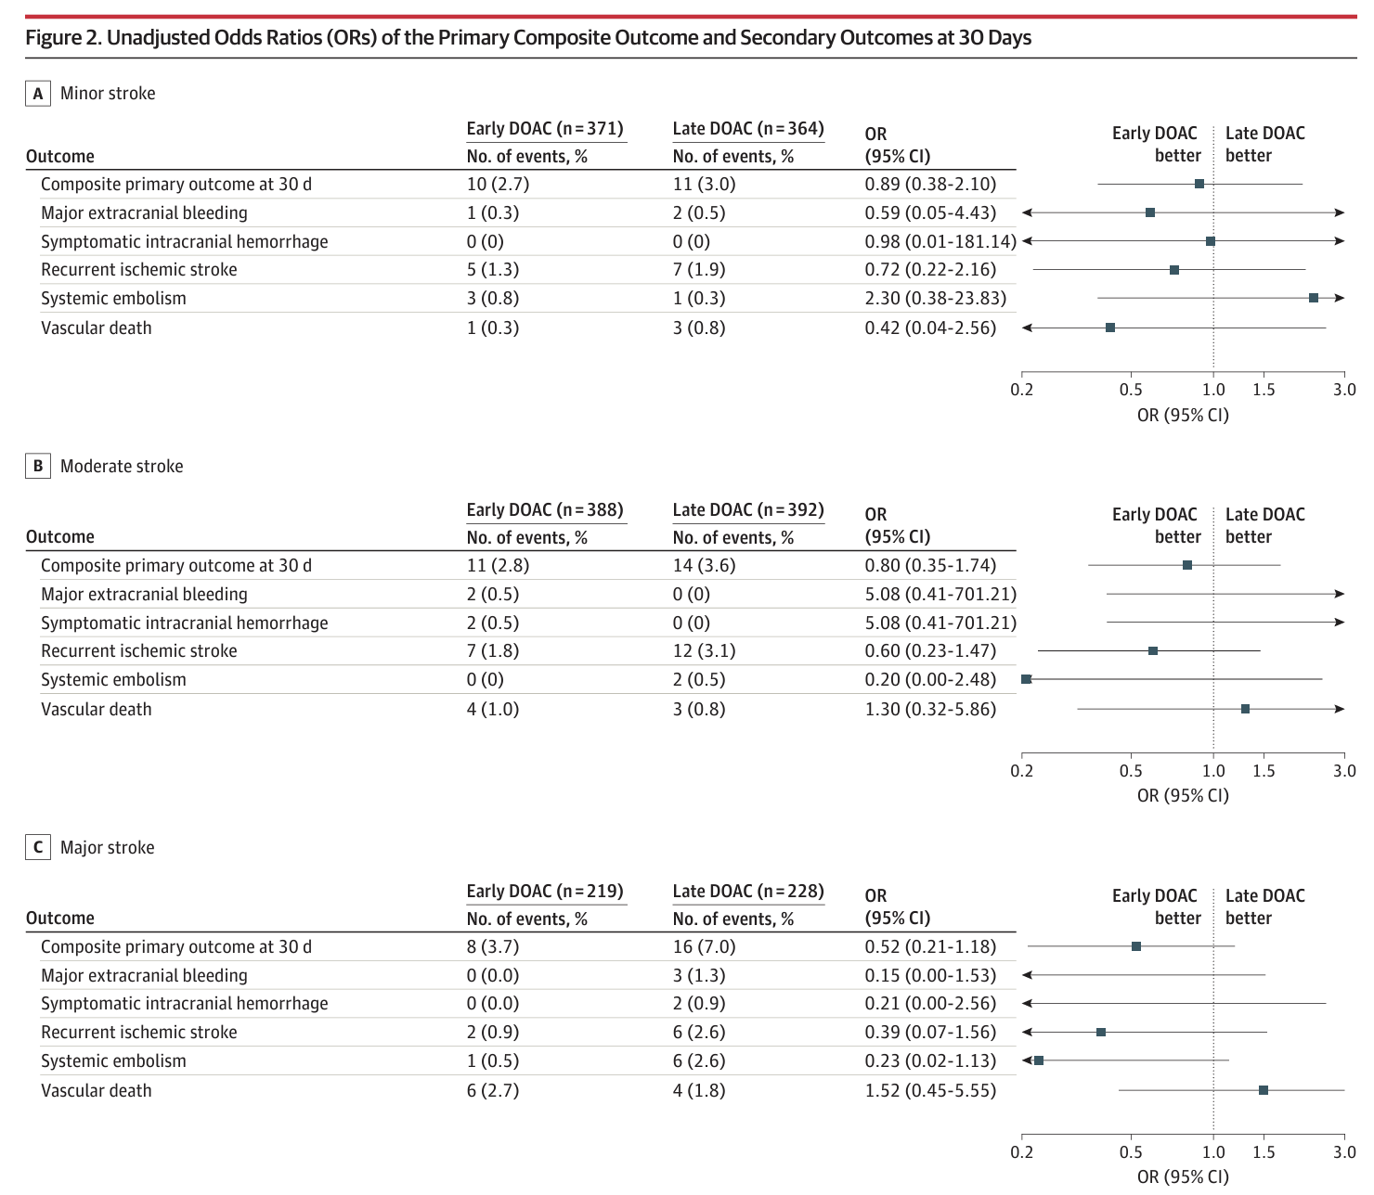
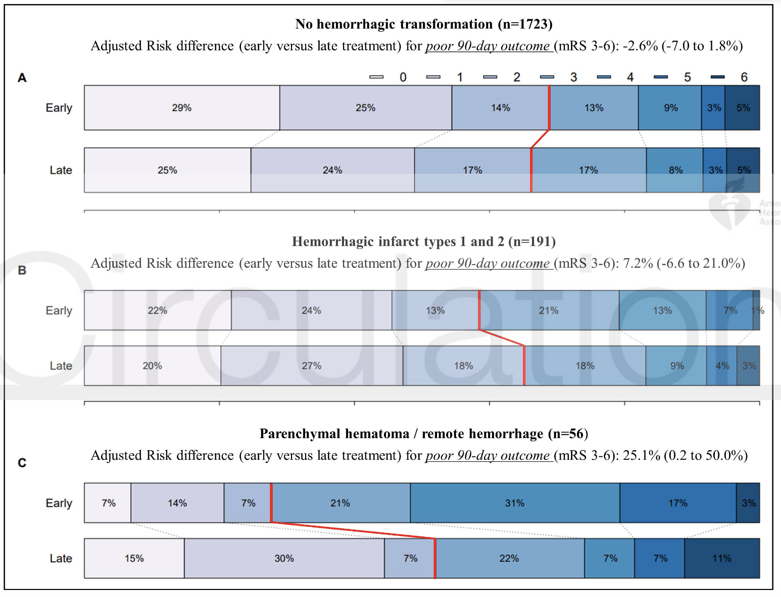
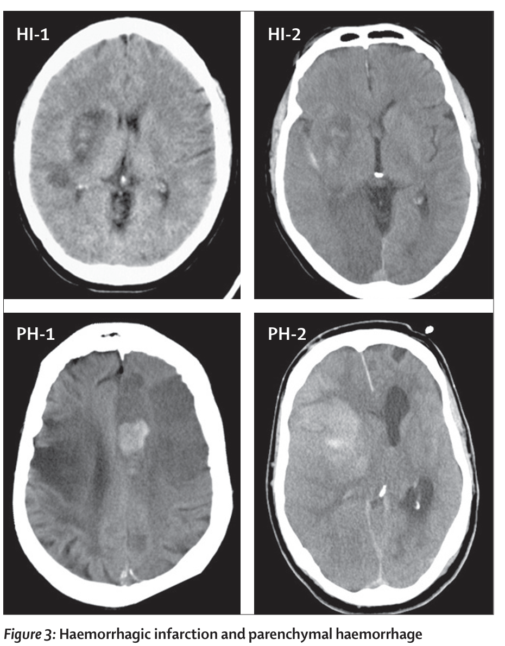
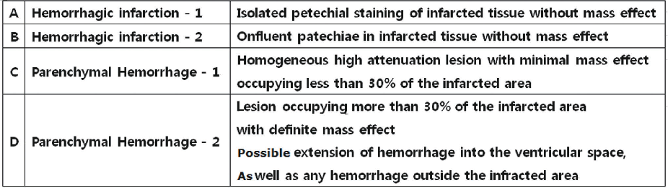
No treatment effect heterogeneity or elevation in sx ICH risk with early DOAC in subgroups: stroke severity, HT 1/2
Early DOAC may worsen functional outcomes in IS with PH

Slide 19
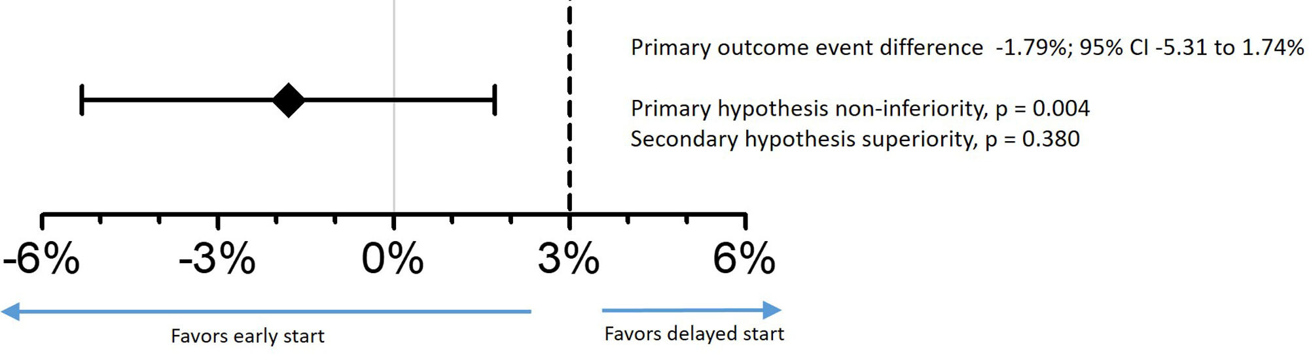
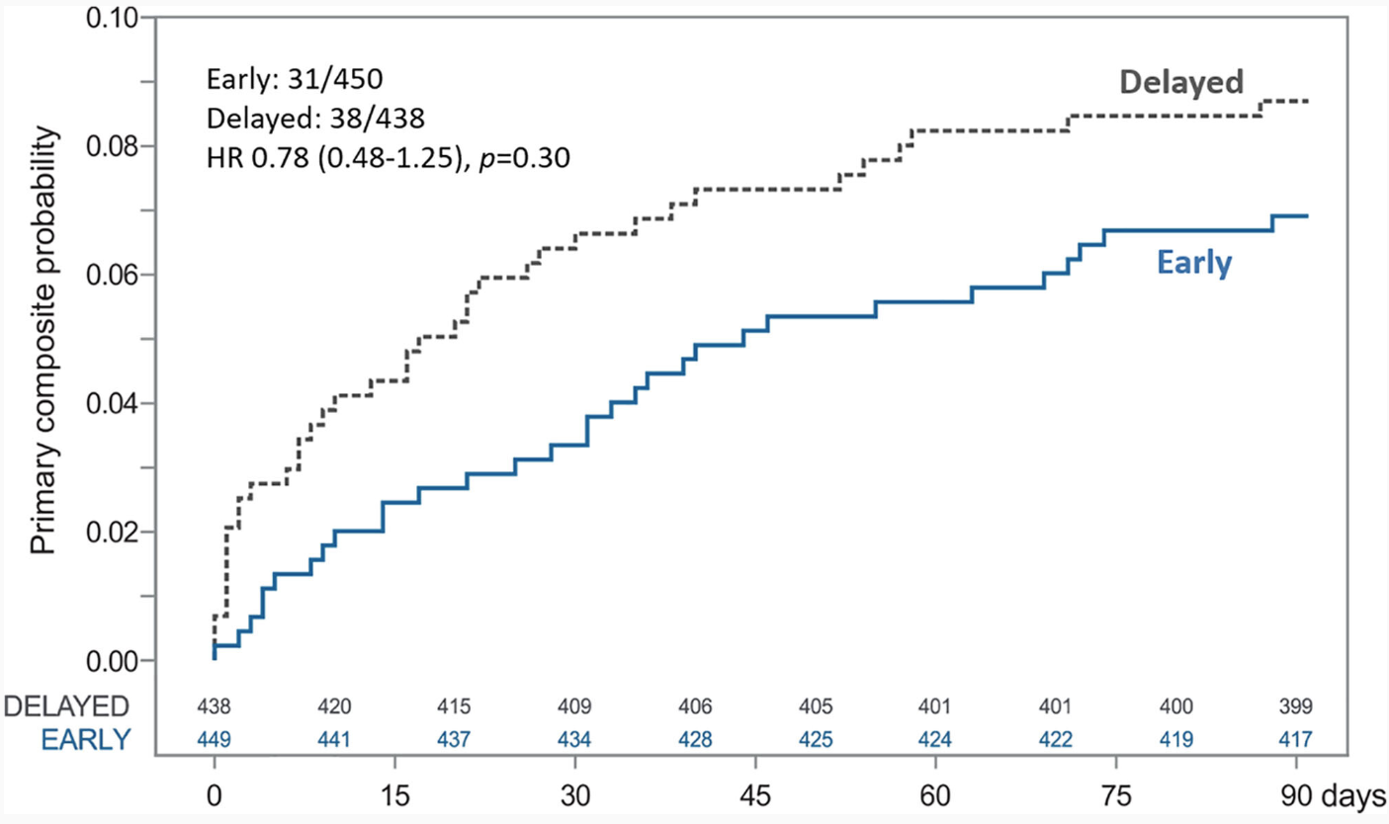
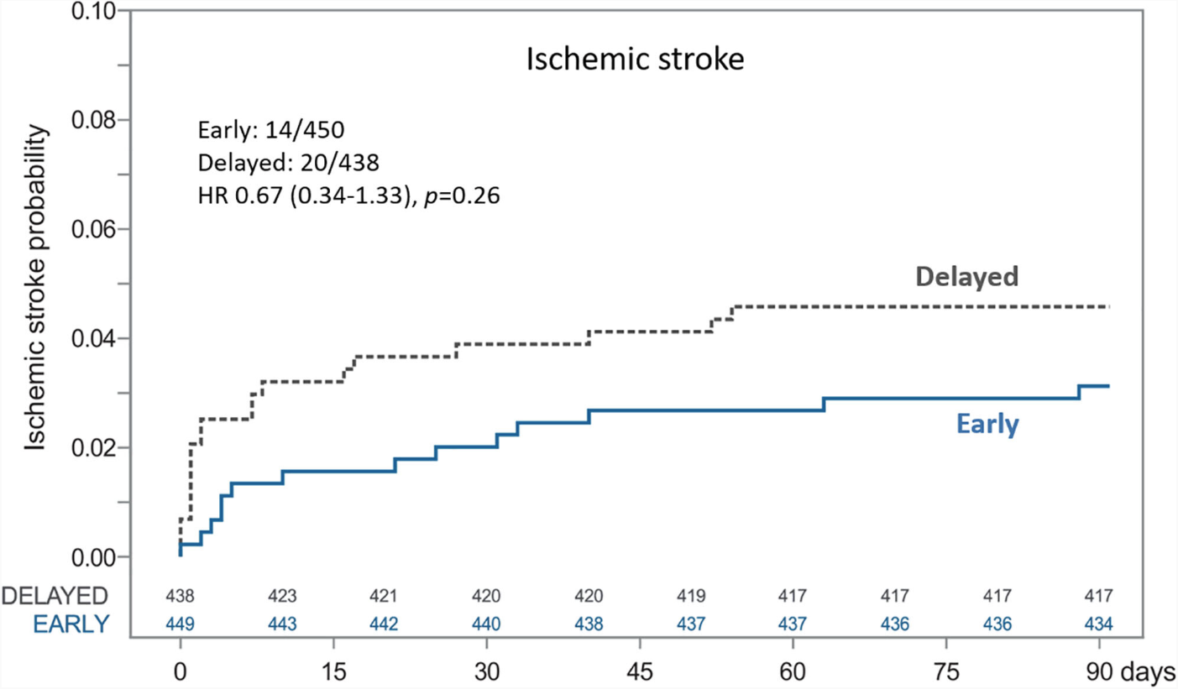
Timing of OAC Therapy in Acute IS w/ AF (TIMING)
Population: acute ischemic stroke + AF
Intervention/Control: early/late DOAC
Early: ≤72h
Delayed: 5-10 days
1° Outcome: composite of recurrent IS, sx ICH, death @ 90d
Non-inferiority margin: 3% → superiority
Terminated early
NIHSS: median 4 (IQR 2-9)

Slide 20
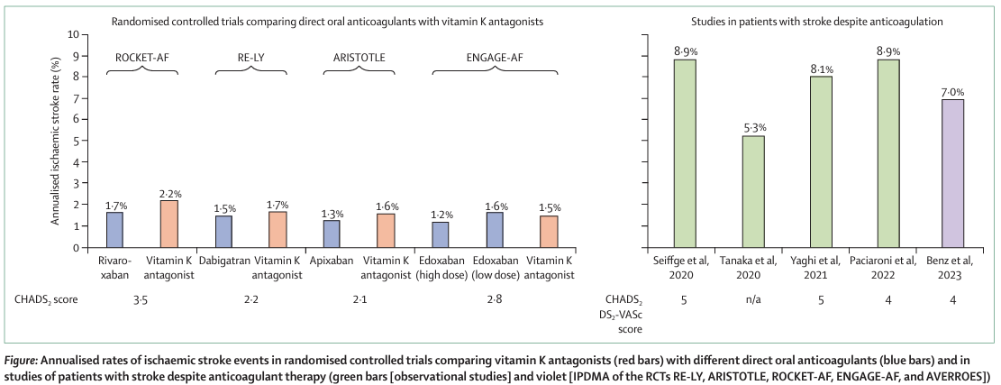
IS despite AC

Slide 21
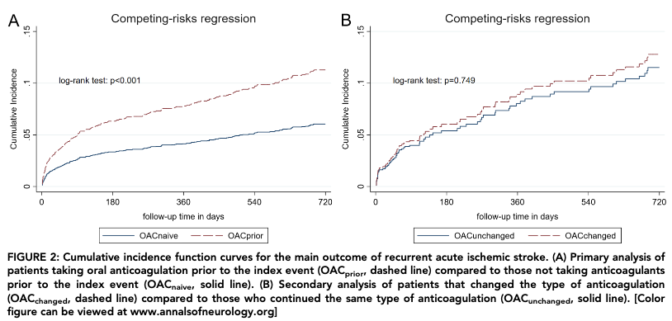
Non-adherence
Alternative high-risk mechanism
Inappropriate dosing
Drug-drug interactions
CYP3A4 / P-glycoprotein efflux pump inducers: ↓ DOAC effect
Carbamazepine, phenytoin, primidone, phenobarbital
Rifampin
Drug-food interaction (rivaroxaban 15mg/20mg: bioavailability ↑ w/ food)

Slide 22
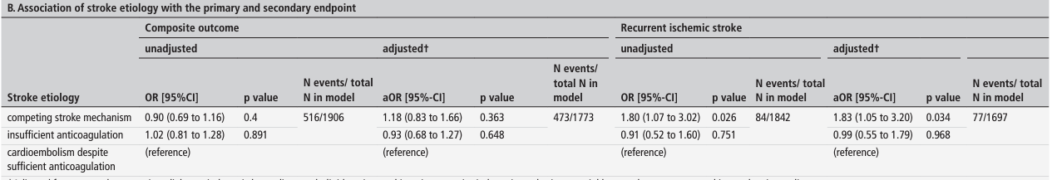
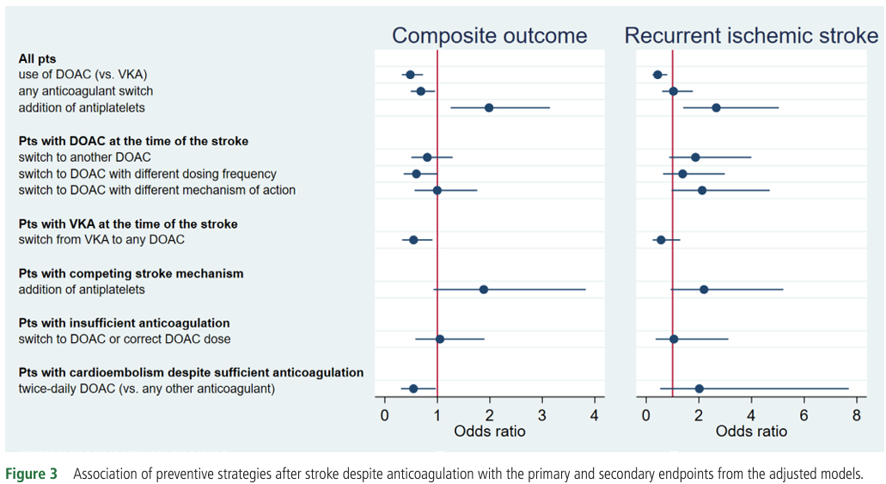
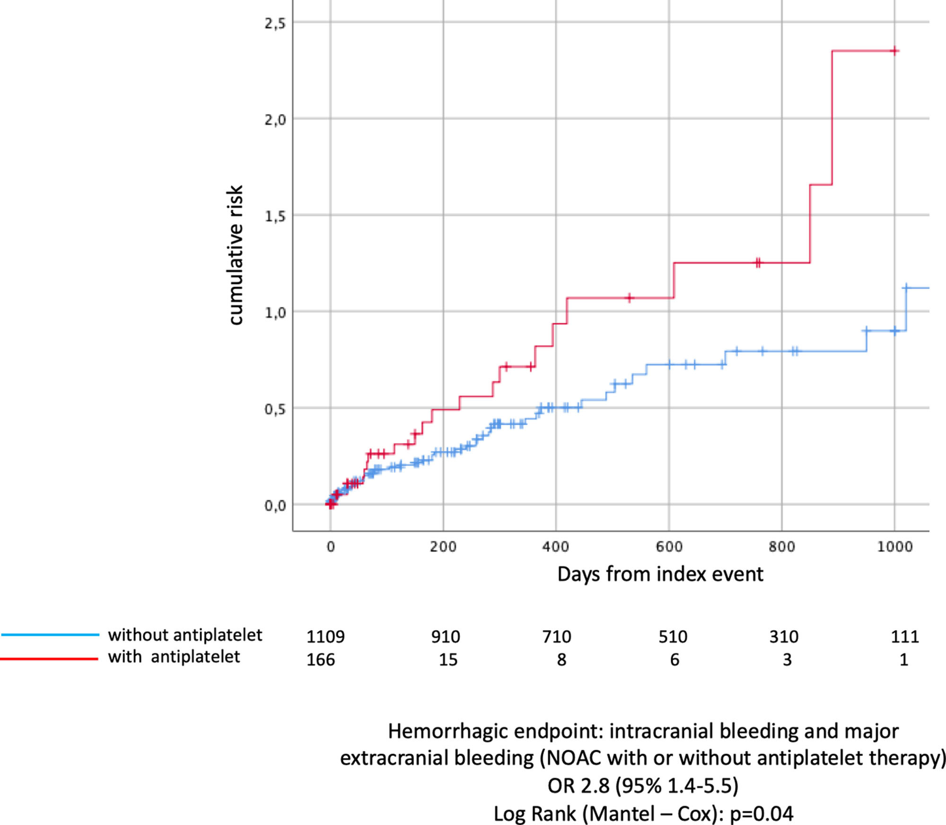

Slide 23
Part 1 - Key Messages
Ensure comorbidities & symptom mgmt. addressed
DOACs (apixaban) preferred
Exceptions: mechanical cardiac valves, mod-severe MV stenosis, rheumatic heart disease
Concurrent AP tx indicated → DOAC + P2Y12 inhibitor
Assess (and re-assess) bleeding risk
Early DOAC for mild-moderate infarcts appears safe & efficacious
Switching 1 DOAC to another has unclear benefit when IS occurs despite AC

Slide 24
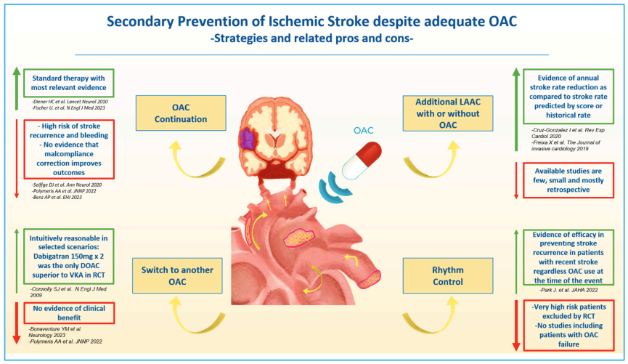
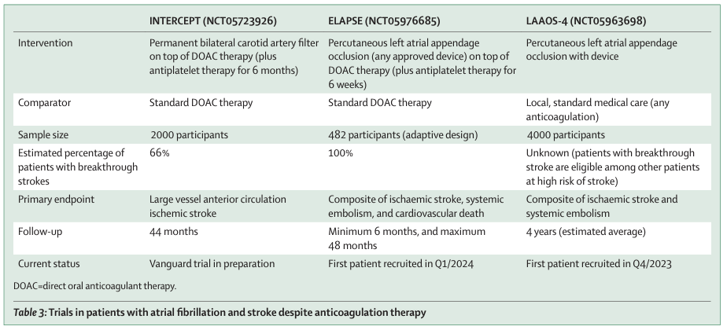
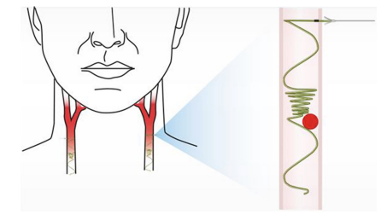

Novel Approaches
Left atrial appendage occlusion
Permanent CCA filters
Early rhythm control
Novel OACs

Slide 25




Rhythm Control

Slide 26



Slide 27


Direct Factor XI & XIa Inhibitors
Factor XI → differential role in hemostasis & thrombosis

Slide 28


Phase 3 AF trials
OCEANIC-AF (asundexian) terminated → lack of efficacy
LIBREXIA-AF (milvexian) → active
LILAC-TIMI 76 (abelacimab) → active
Phase 2b: 67% ↓ risk of hemorrhage vs. rivaroxaban (N=1287)
Prior stroke excluded

Slide 29


Cardiac Rhythm Evaluation – AF after IS
Range 24 hours – 3 years
RCTs → designed/powered to detect $∆$ AF rates (not IS rates)

Slide 30


Cryptogenic
~50% Cryptogenic
66% Cryptogenic
cSVD or LAA stroke

Slide 31


Prolonged cardiac rhythm monitoring in stroke populations:
Increased AC initiation
Unclear effect on recurrent stroke risk
AF burden often low

Slide 32



LOOP Study
Population: 70-90 y + HTN / DM / prior stroke / HF
Intervention/Control: ILR / usual care
1° Outcome: stroke / systemic embolism
* CHA₂DS₂-VASc: median 4 (IQR 3-4)
* Prior stroke/TIA/SE: ~25%
* AF detection: ILR ~32%, usual care ~12%

Slide 33



Slide 34


AF Burden & IS Risk
Predictors of AF burden
Age
Left atrial enlargement
Natriuretic peptides
Frequent PACs
Burden of paroxysmal AF ~ IS risk
ASSERT (post-hoc analysis) → 24h
SOS-AF project → 1h
RATE study → 20s
CHA₂DS₂-VASc X AF Burden interaction
IS risk ↑ permanent > paroxysmal AF

Slide 35




ARTESIA
Population: 6m $≤$ AF$≤$ 24h detected by PM, defibrillator, cardiac monitor + CHA₂DS₂-VASc $≥$ 3, age $≥$ 55y
Intervention/Control: apixaban / ASA
AF > 24h or clinical AF → study drug d/c’ed & AC initiated
1° Outcome: stroke / systemic embolism
* CHA₂DS₂-VASc: mean ~4 ($≥$4: 61%)
* Prior stroke/TIA/SE: 9%

Slide 36




NOAH-AFNET 6
Population: AHREs$≥$6m (implanted cardiac devices) + age $≥$65y + additional stroke risk factor
No AF
Intervention/Control: edoxaban / placebo
1° Outcome: composite – stroke, SE, CV death
* CHA₂DS₂-VASc: median 4 (IQR 3-5)
Prior stroke/TIA: 10%
AHREs duration: median 2.8h (IQR 0.8-9.4)
ASA indication: ~54%

Slide 37


Slide 38

Wearables
Photoplethysmography
Single-lead ECG
Require EKG & clinical confirmation
Limitations / Sources of Error
Motion
Skin contact
Discrimination b/w similar dysrhythmias
Longer episodes for detection when inactive

Slide 39
Key Messages: Prolonged Cardiac Rhythm Monitoring for Secondary Stroke Prevention
AF detected after stroke is common but confers lower risk
Prolonged monitoring increases AF detection, but unclear if it reduces recurrent stroke risk
AF burden is a determinant of IS risk
Burden of subclinical, device-detected AF to confer net clinical benefit w/ AC (reduction is stroke risk > hemorrhage risk) is not clear (but likely small)
AF begets AF (AHREs → subclinical AF → clinical AF)
Wearables will likely supplant current rhythm monitoring approaches

Slide 40


Left Atrial Appendage Occlusion (LAAO)
80-90% thrombi → LA appendage (NVAF)
TEE, surgery, autopsy
Cardioversion: TEE
Acute stroke: cardiac CT
50-60% in valvular (rheumatic) AF

Slide 41


Percutaneous LAAO & Warfarin
PROTECT AF (N=707)
Non-inferiority, open-label
Population: nonvalvular AF eligible for AC, CHADS₂≥1
Intervention/Control: LAAO-Watchman / warfarin (2:1)
LAAO → warfarin x 45 d, then DAPT x 6 m, then ASA alone
Outcome: composite (stroke, SE, CVD death)
PREVAIL (N=407)
FDA mandated confirmatory study

Slide 42

Percutaneous LAAO & DOACs
PRAGUE-17 (N=402)
Non-inferiority, open-label
Population: nonvalvular AF +
major hemorrhage, cardioembolic event i/s/o OAC, &/or CHADS₂VASc≥3 + HAS-BLED>2
Intervention/Control: LAAO-Watchman/Amulet or DOAC
DOAC → ~96% apixaban
Outcome: composite (stroke, TIA, SE, CVD death, hemorrhage, complications)

Slide 43

Percutaneous LAAO
Risks → device-related thrombus (2-5%), residual leak
Post-procedural antithrombotics
45d DOAC + AP → ASA alone (WATCHMAN FLX)
6m DAPT → ASA alone (AC contraindication)

Slide 44


Surgical LAAO
LAAOS-III (N=4811)
Population: AF + CHADS₂VASc≥2 undergoing cardiac surgery
Intervention/Control: surgical LAAO / no LAAO
Outcome: Ischemic stroke / SE
Mean CHADS₂VASc ~4
~77% OAC (3 y)

Slide 45


Slide 46


AF antithrombotic management after ICH
(Annual) Recurrence Risk
CAA: ~9%
HTN: <2%
Mixed: ~5%

Slide 47


Aspirin
RESTART (N=537)
Population: ICH taking antithrombotic
Intervention/Control: start / avoid AP
Outcome: recurrent sx ICH
AF → ~25%
AP start → median 76 d

Slide 48


Anticoagulation
CHADS2VASc > estimated risk of ICH recurrence?
Uncertain benefit of AC resumption (stroke/CVD death)
Timing → ~8 weeks

Slide 49

Percutaneous LAAO
Observational studies
Retrospective
N = small
→ Low event rates after LAAO

Slide 50
Key Messages – LAAO & Antithrombotic Mgmt After ICH
LAAO reasonable consideration when hemorrhage risk is unacceptably high, BUT:
Benefit : Risk (in comparison to DOAC) not established in stroke populations
LAAO + DOAC superior to DOAC alone in ischemic stroke despite AC?
Optimal antithrombotic mgmt. after ICH in AF populations is uncertain
Enroll into ASPIRE whenever possible
ASA resumption safe

Slide 51


